Slide 1
Loan defaulter prediction
Capstone project
Sundararajalu Priya

Slide 2
Objective
Create Predictive model to classify each borrower as defaulter or not using the data collected before granting the loan .
Minimize the risk of borrowers defaulting the loans using created model.

Slide 3
Approach
We would be using classification algorithm for solving our problem. It establish relation between input features and output feature.

Slide 4


process
Problem Understanding
Data Collection And Preprocessing
Model Building
Exploratory Data Analysis
Model Evaluation
Model Deployment

Slide 5
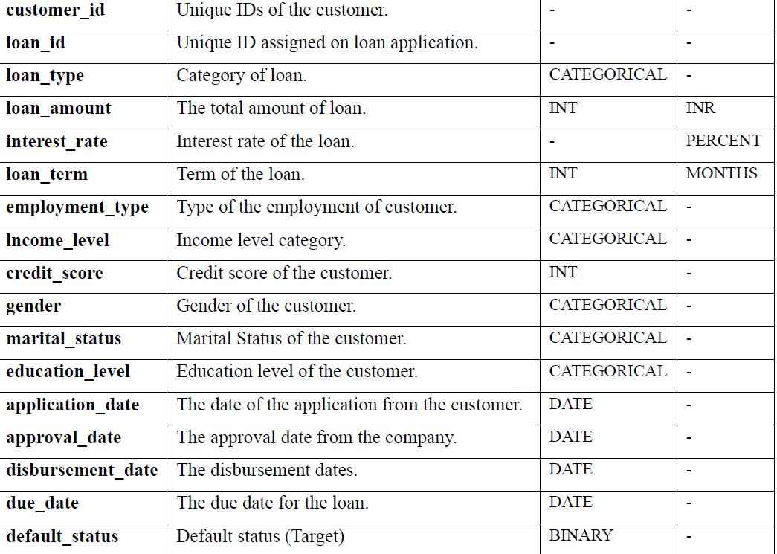

Understanding of the dataset

Slide 6
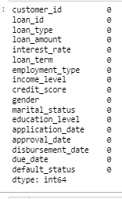
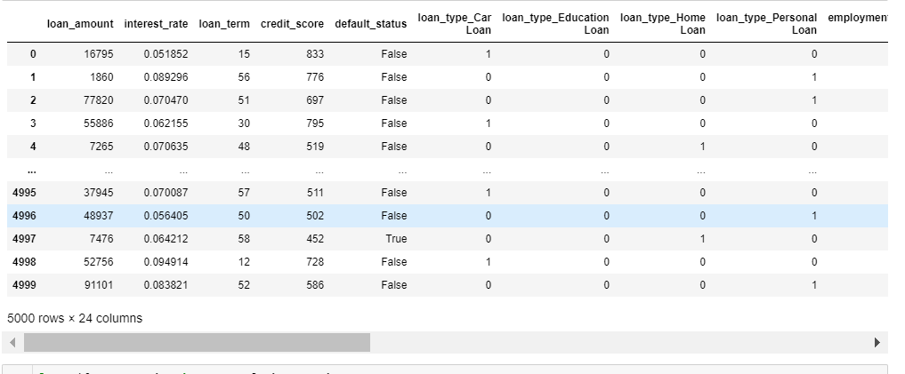

Data preparation
Is there any missing data?
Encoding of the categorical features

Slide 7
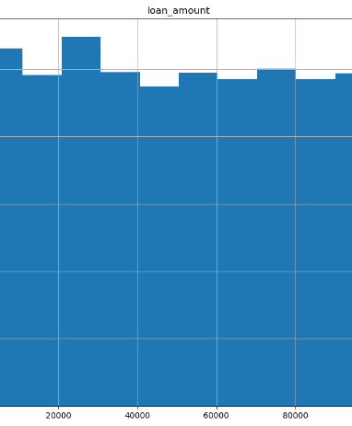
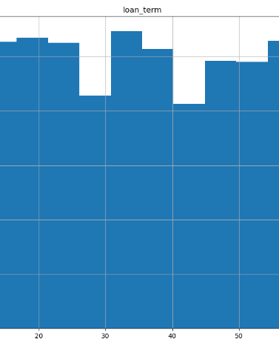
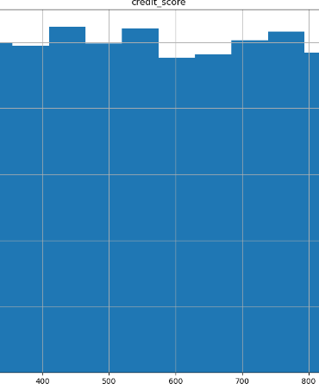
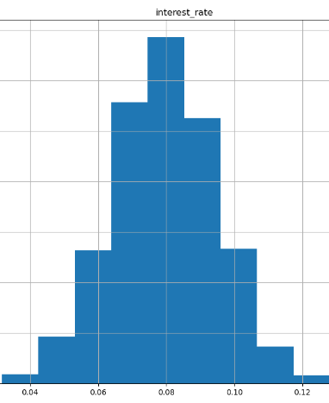
Data distribution
Loan Amount
Loan Term
Credit Score
Interest Rate

Slide 8
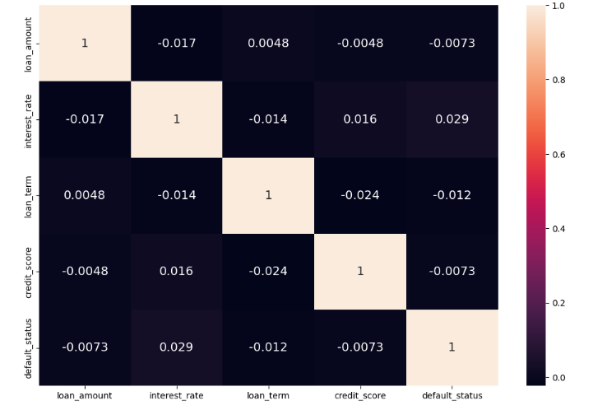
Correlation

Slide 9
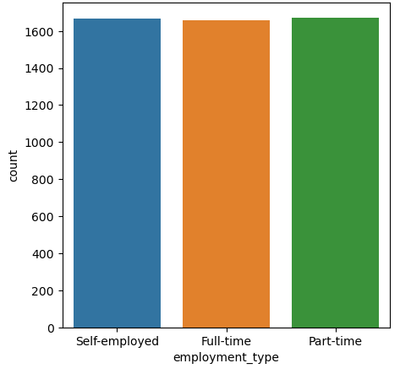
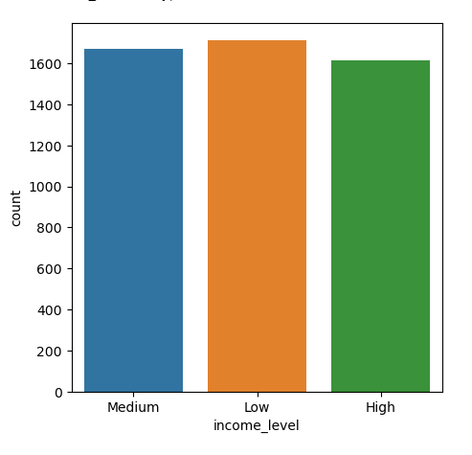
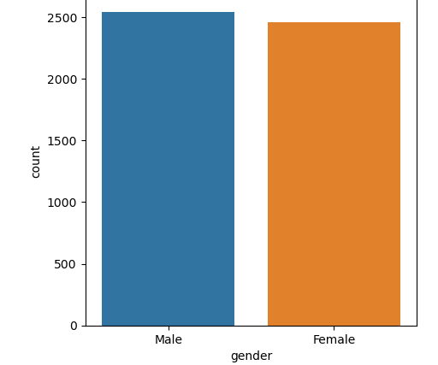
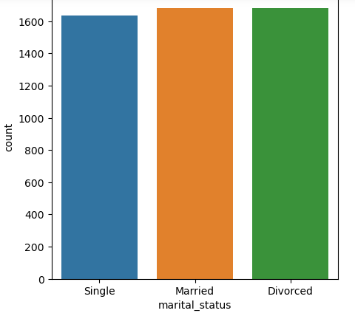
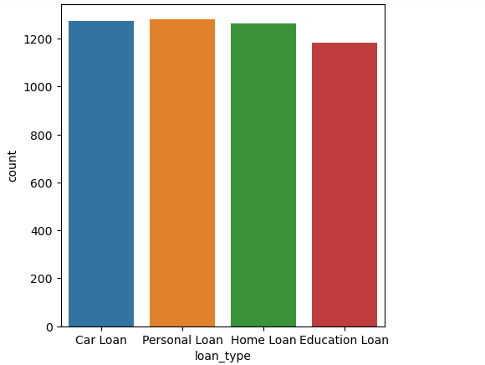
Categorical data distribution

Slide 10
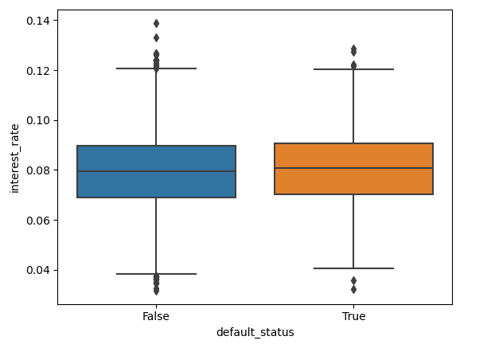
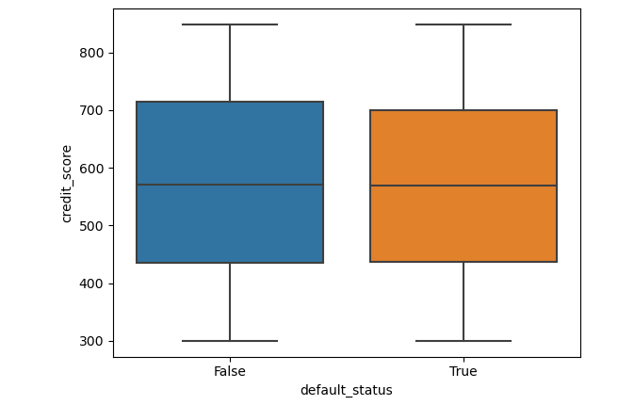
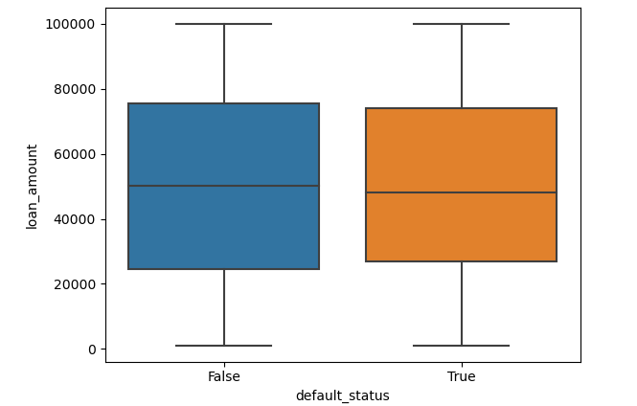

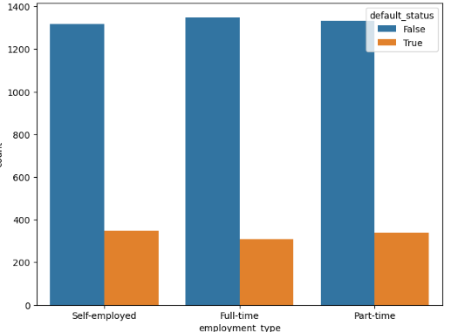
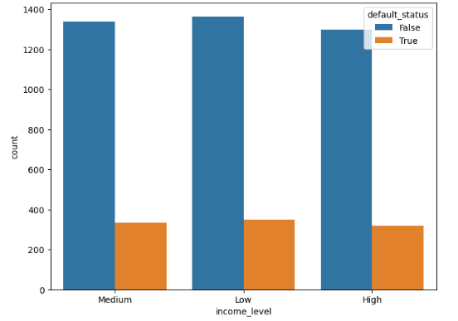
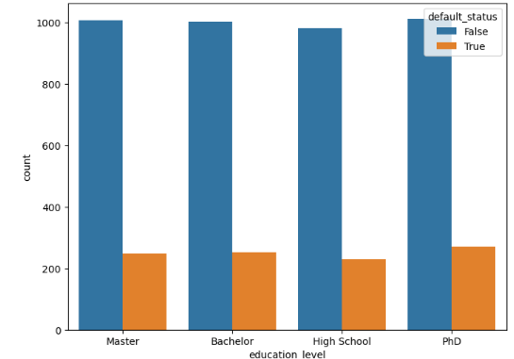
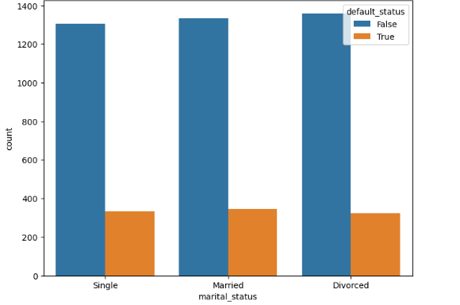
Comparing categories with target variable
Interest Rate
Credit Score
Loan Amount
Loan Type
Employment Type
Income Level

Slide 11
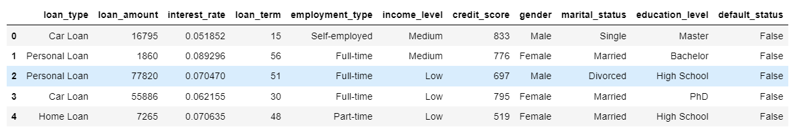
Removed the redundant features

Slide 12
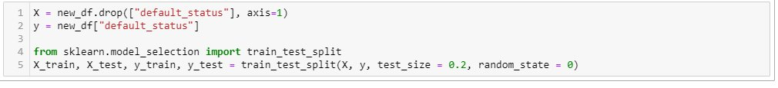
Splitting the data into training and test dataset

Slide 13

Models Applied
LOGISTIC REGRESSION
SVM
DECISION TREE
RANDOM FOREST CLASSIFIER
NAÏVE BAYES
GAUSIAN NB
KNEIGHBOURS CLASSIFIER

Slide 14
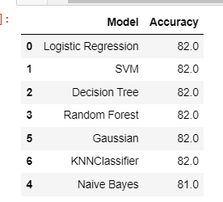
MODEL COMPARISION

Slide 15
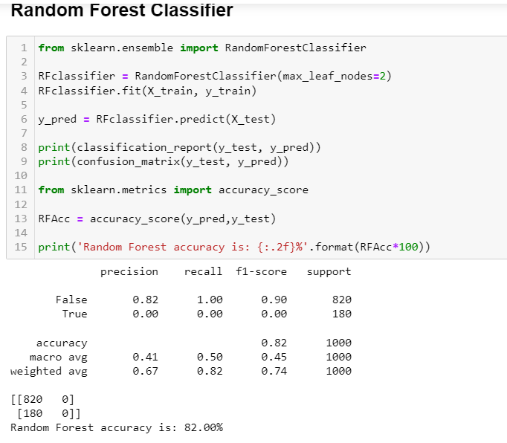
Random forest classifier

Slide 16
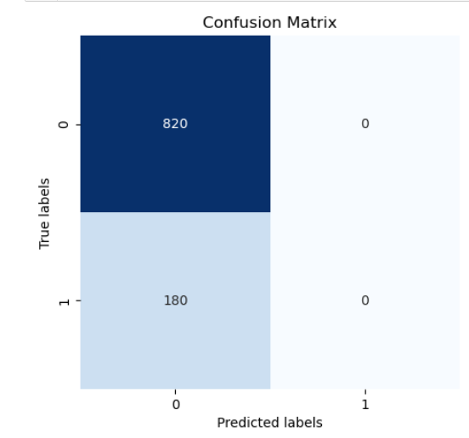
Confusion matrix
TP
FP
TP
FN
TN

Slide 17
This model can be used in
Fraud detection in credit card transactions.
2.Identifying high-risk investments

